Slide 1
Objective structured picture examination{OSPE} practice sessions 3
Dr Babatola A.O
Department of Paediatrics
Afe Babalola University{ABUAD} Ado-Ekiti

Slide 2
Sugar: nil
Protein: ++
Leucocytes: 3-4/mm³
Bacteria: -
Nitrites: nil
Red blood cell casts: ++
Culture: No growth after 48hours

Slide 3
Review the result above
A] The patient most likely has acute glomerulonephritis T
B] The patient most likely has nephrotic syndrome F
C] The patient most likely has urinary tract infection F
D] The patient with the result will benefit from furosemide T
E} The patient with the result may have a history of skin rash prior to the onset of present symptoms. T

Slide 4
A 13 YEAR OLD MALE PRESENTS WITH CONFUSION. HE HAS BEEN DIABETIC SINCE AGE 6. COMPLAINS OF ABDOMINAL PAIN AND POOR APETITE HE IS VOMITTING AND HAD STOPPED TAKING HIS INSULIN. HIS BLOOD GLUCOSE IS HIGH.
Na 130meqv/l
Cl 80meqv/l
HCO3 10meqv/l

Slide 5
Review the case above
A] Urinalysis must be done for this patient T
B] The likely diagnosis is Diabetic ketoacidosis T
C] potassium should not be part of the management F
D] the patient is most likely severely dehydrated T
E] the patient could develop cerebral oedema in the course of management T

Slide 6
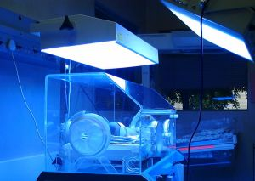

Slide 7
The baby in the incubator is preterm LBW and noticed to developed jaundice at 24hrs of life
A] The jaundice is most likely physiologic F
B] The baby is at risk of hypothermia T
C] The serum bilirubin is most likely more than 20mg/dl F
D] The baby does not need more than daily maintenance fluid. F
E] The baby may need aminophylline as part of the management T

Slide 8
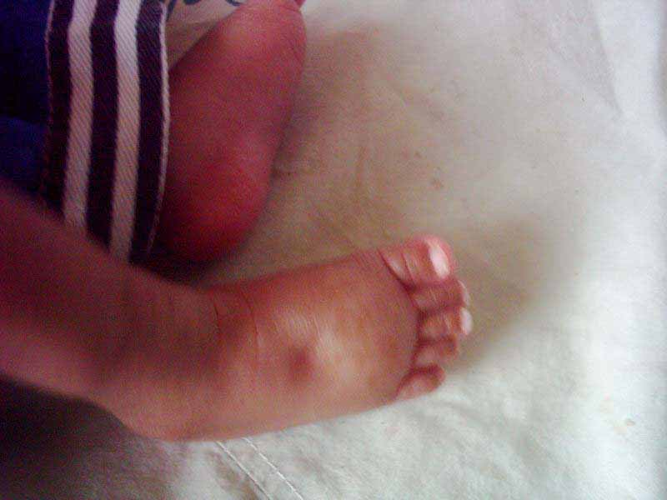
6

Slide 9
Concerning the picture above
A] severe protein energy malnutrition is a differential diagnosis T
B] Nephrotic syndrome is a differential diagnosis T
C] Congestive cardiac failure may be the cause T
D] This is elephantiasis F
E] There may be associated sacral oedema T

Slide 10
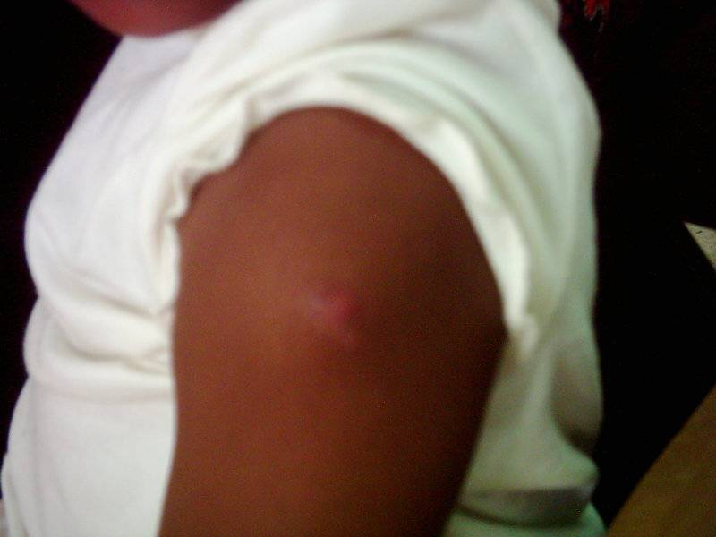
2

Slide 11
The child above has a BCG scar
A] This vaccine is usually given at birth T
B] The administration of this vaccine can be complicated by axillary adenitis T
C] This vaccine is a live vaccine and therefore contraindicated in patients with severe immunosuppression T
D]This vaccine offer absolute protection against tuberculosis F
E] All the above are correct F

Slide 12
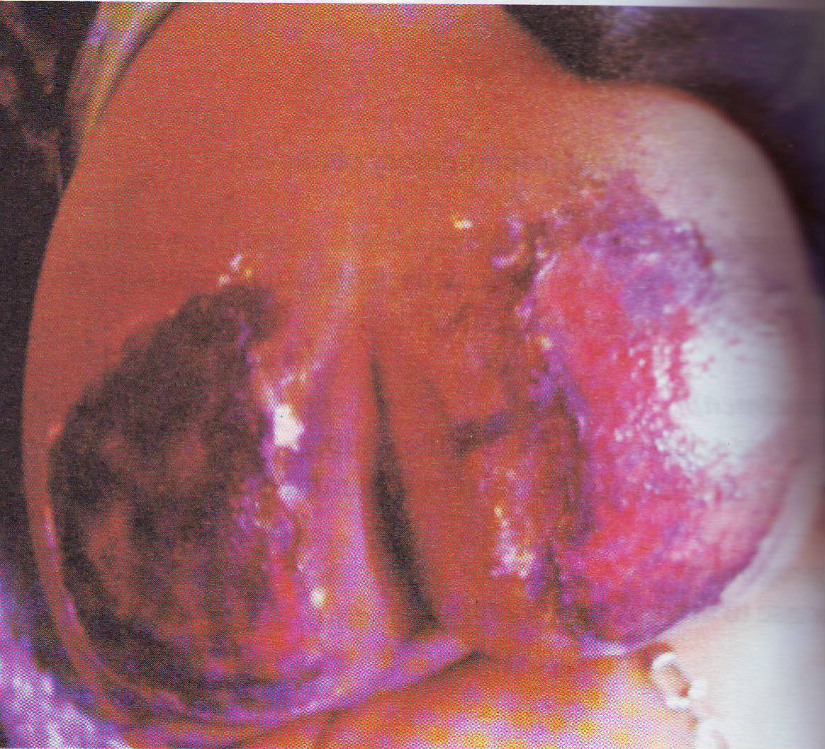

Slide 13
The above patient suffered burns to the gluteal region as shown above
A] Patient should be admitted to the hospital T
B] Analgesics are not needed in the management of this patient F
C]This is probably a case of child abuse T
D] wound care is part of the management of this patient T
E] None of the above is correct F

Slide 14
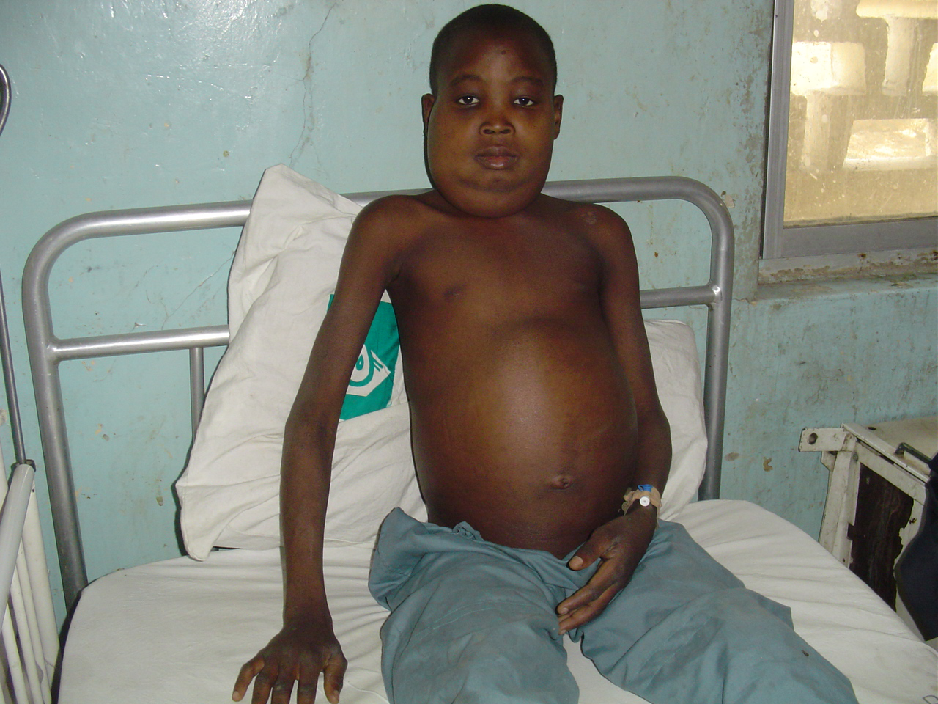

Slide 15
The patient above has generalised anasarca with a provisional diagnosis of nephrotic syndrome
A] There is associated massive proteinuria of > 40mg/m2/hr T
B] There is associated serum hypoalbuminemia < 2.5g/dl T
C] urinalysis is a very important investigation T
D] steroid is not useful in the management of the patient F
E] There may be associated difficulty with breathing T

Slide 16
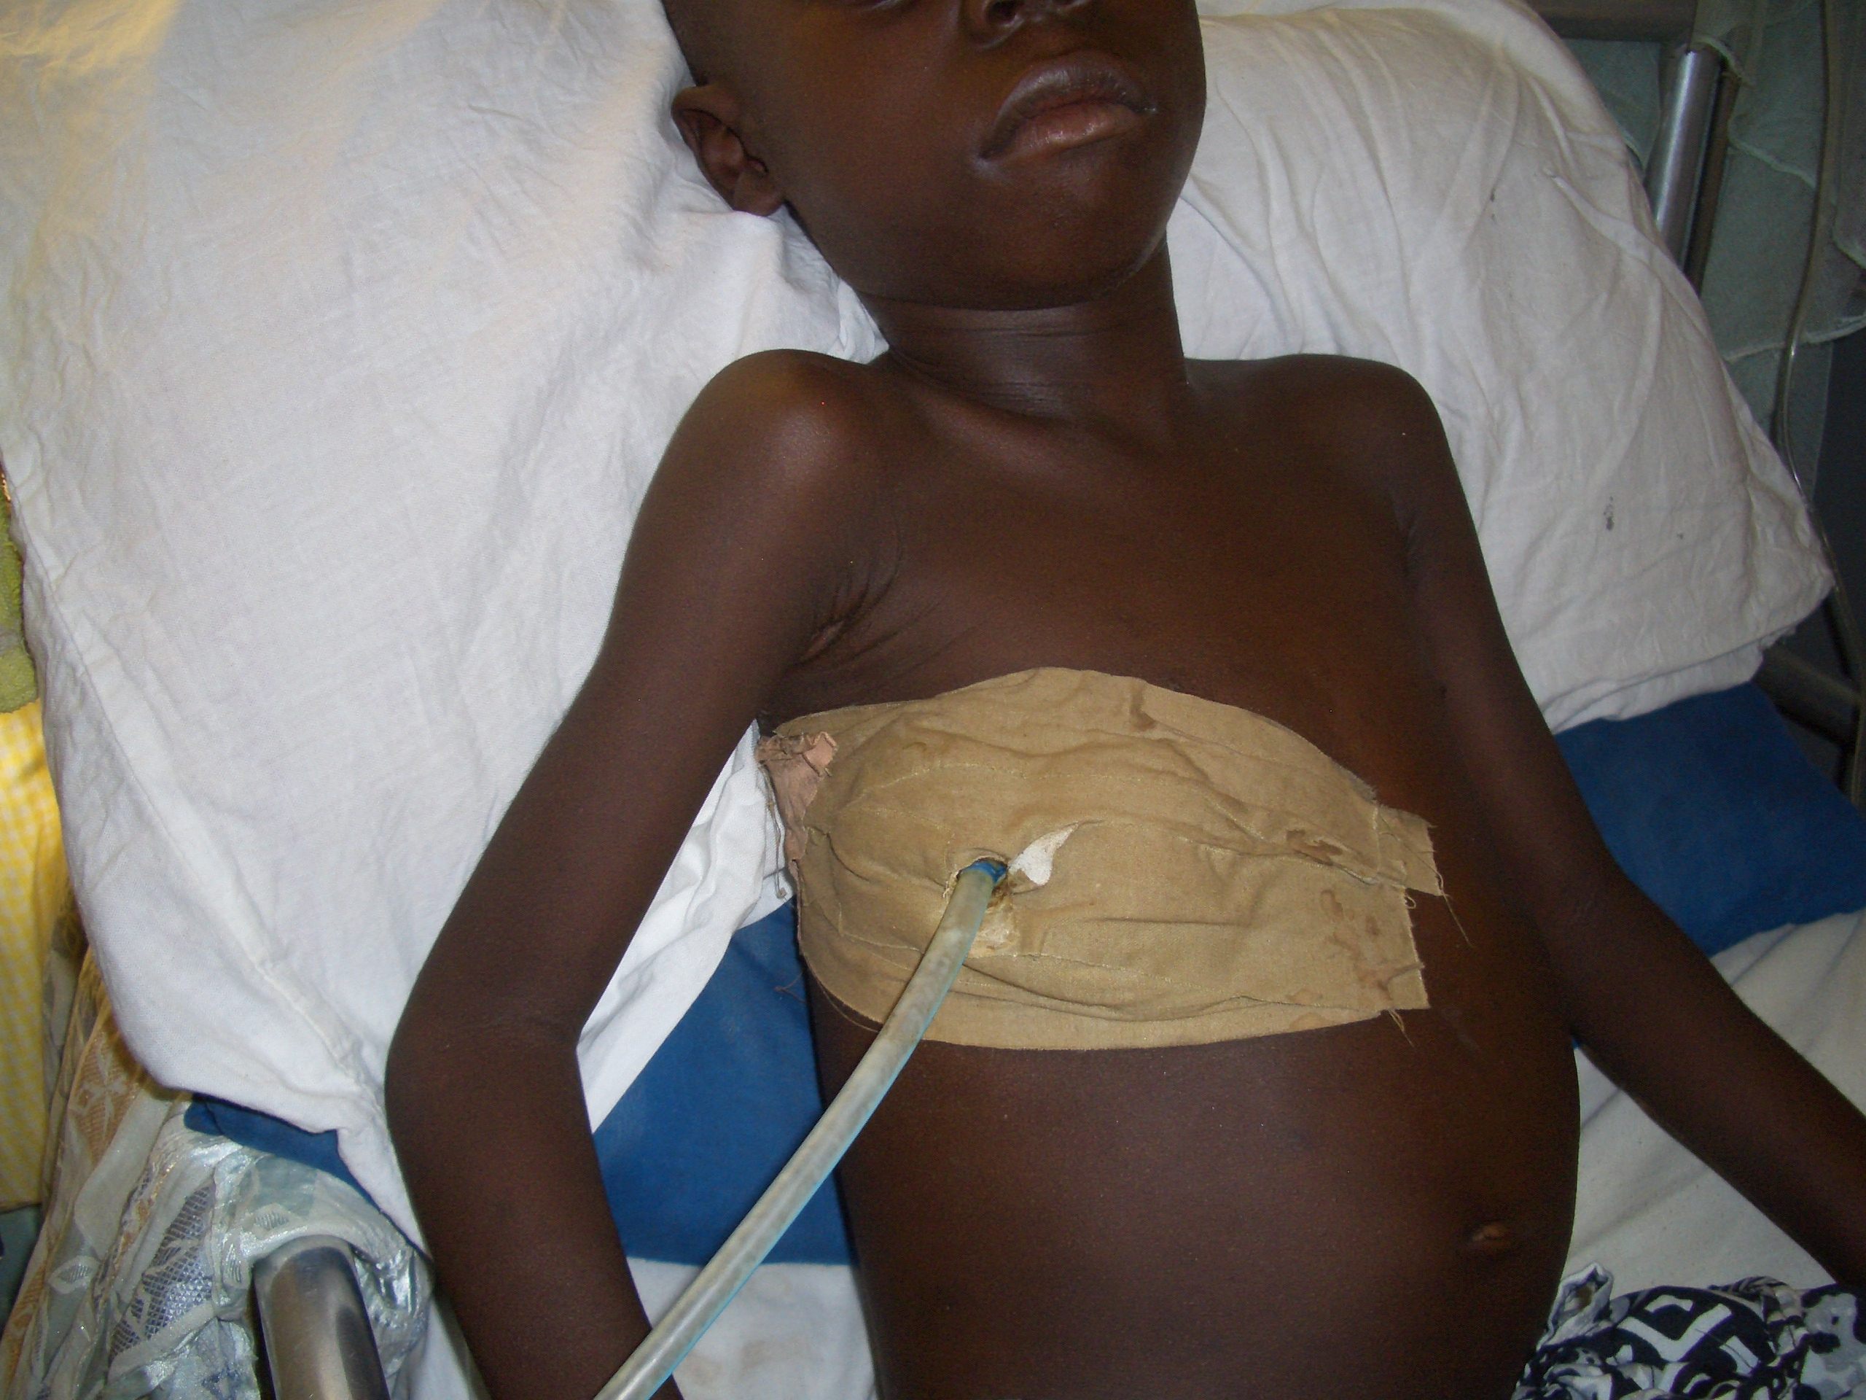
4

Slide 17
The patient above has chest tube in-situ
A] The condition above may be a complication of bacteria pneumonia T
B] The condition may result from systemic lupus erythematosus T
C] The condition may accompany tuberculosis T
D] The effluent from the drain is exudate if the protein is <3.0g/dl F
E] prior to insertion of the chest tube, Chest x-ray may show obliteration of the costophrenic and cardiophrenic angles T

Slide 18
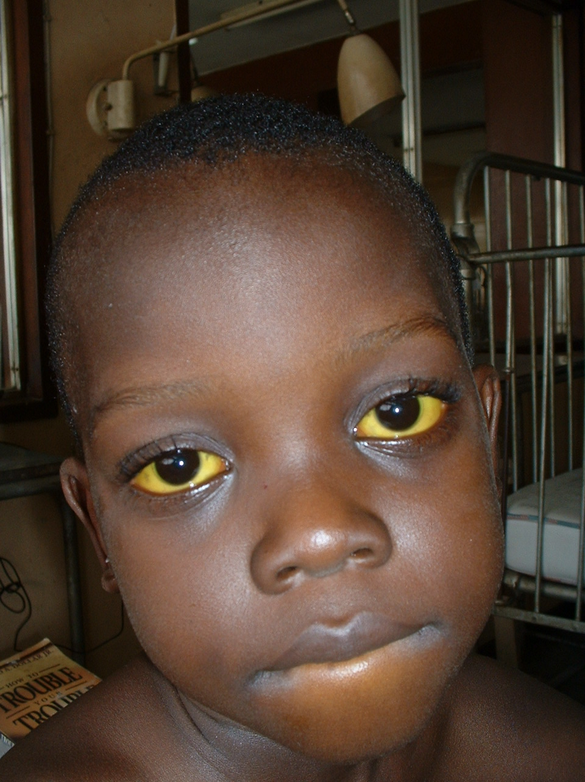

Slide 19
This 8 year old child has chronic hepatitis
A] Probably acquired it through feaco-oral means T
B] Liver cirrhosis is a late complication. T
C] There may be associated passage of clay colored stools T
D] Lamivudine may have a role to play in the management of this patient T
E] Patient may acquired the condition through blood transfusion T

Slide 20
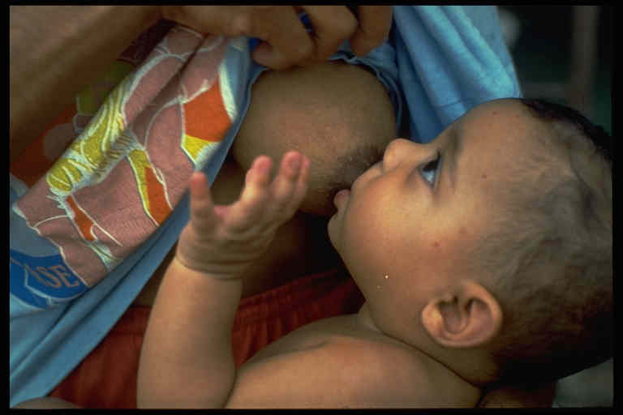

Slide 21
Of the photo above
A] The national recommendation is exclusive breastfeeding for 6 months T
B] Prolonged breastfeeding in HIV infected children is breastfeeding more than 2 years F
C] one of the signs of proper attachment in breastfeeding is that there is more areola than below. T
D] Breast feeding protects against chest infections and diarrhea T
E] Breast milk contains anti-infective agents T

Slide 22
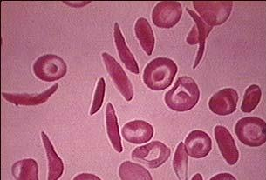

Slide 23
Concerning the condition depicted on the slide
A] Dehydration is a factor that can worsen the condition in individuals T
B] Patient with the condition can have hyposthenuria T
C] folic acid is one of the drugs used in the management of the condition T
D] This is probably a case of acute leukemia F
E] Patient with the condition will benefit from bone marrow transplantation T

Slide 24
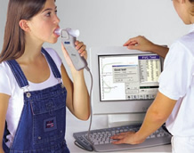

Slide 25
Concerning the picture above
A] Procedure can be used to make a diagnosis of asthma T
B] Patient may have associated eosinophilia T
C] Patient may present with chest tightness T
D] Management of the patient is solely pharmacotherapy F
E] All the above are correct F

Slide 26
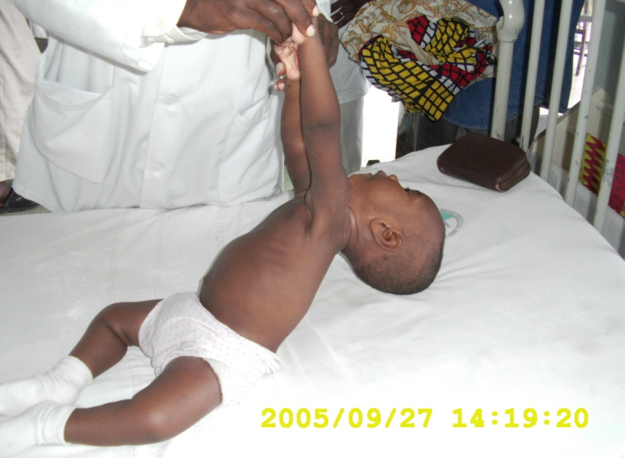
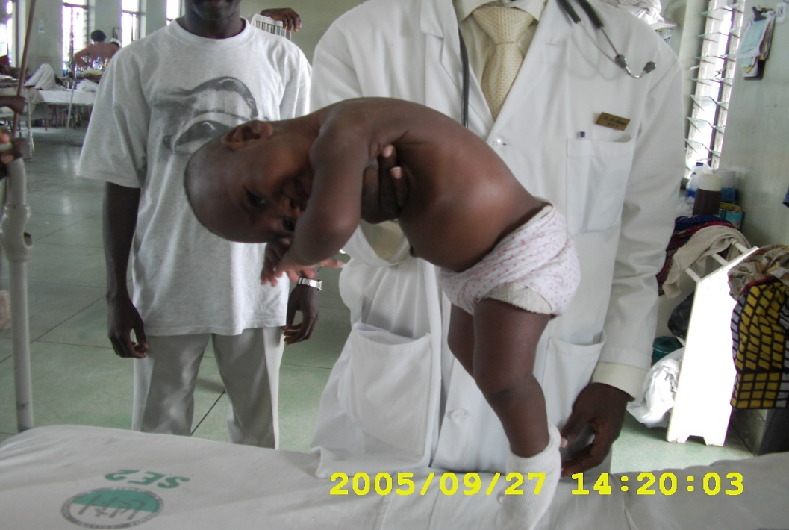

Slide 27
Concerning the picture above
A] The tests demonstrates hypertonia F
B]The above can be present in cerebral palsy T
C] Usually demonstrated in Down syndrome T
D] could be demonstrated in spinal muscular atrophy T
E] muscle biopsy may be indicated T

Slide 28
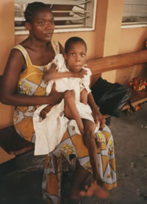
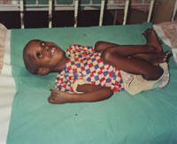

Slide 29
The children in the above picture have cerebral palsy
A] Most preterm infants with cerebral palsy have spastic diplegia T
B] There may be associated swallowing difficulties and drooling. T
C] Most preterm infants with cerebral palsy have dyskinetic type F
D] hearing assessment is not important in the management F
E] Hand preference in the 1st year of life is an early pointer to cerebral palsy T

Slide 30
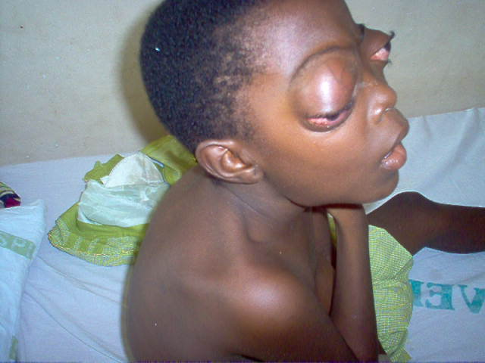

Slide 31
Concerning the picture above PROPTOSIS
A] Graves disease is a differential diagnosis T
B] surgery may be indicated T
C] beta adrenergic blocking agents may be indicated T
D] cavernous sinus thrombosis is a differential diagnosis T
E] magnetic resonance imaging may be required T

Slide 32
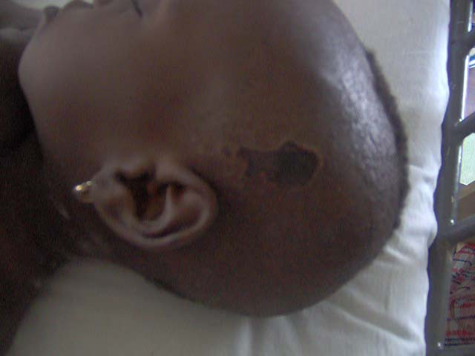
10

Slide 33
The above child developed necrosis of the scalp following administration of the below intravenously
A] intravenous fluid 4.3% Dextrose/0.18 saline F
B] calcium gluconate injection T
C] cyclophosphamide injection T
D] phenytoin injection T
E] 50% dextrose water T

Slide 34
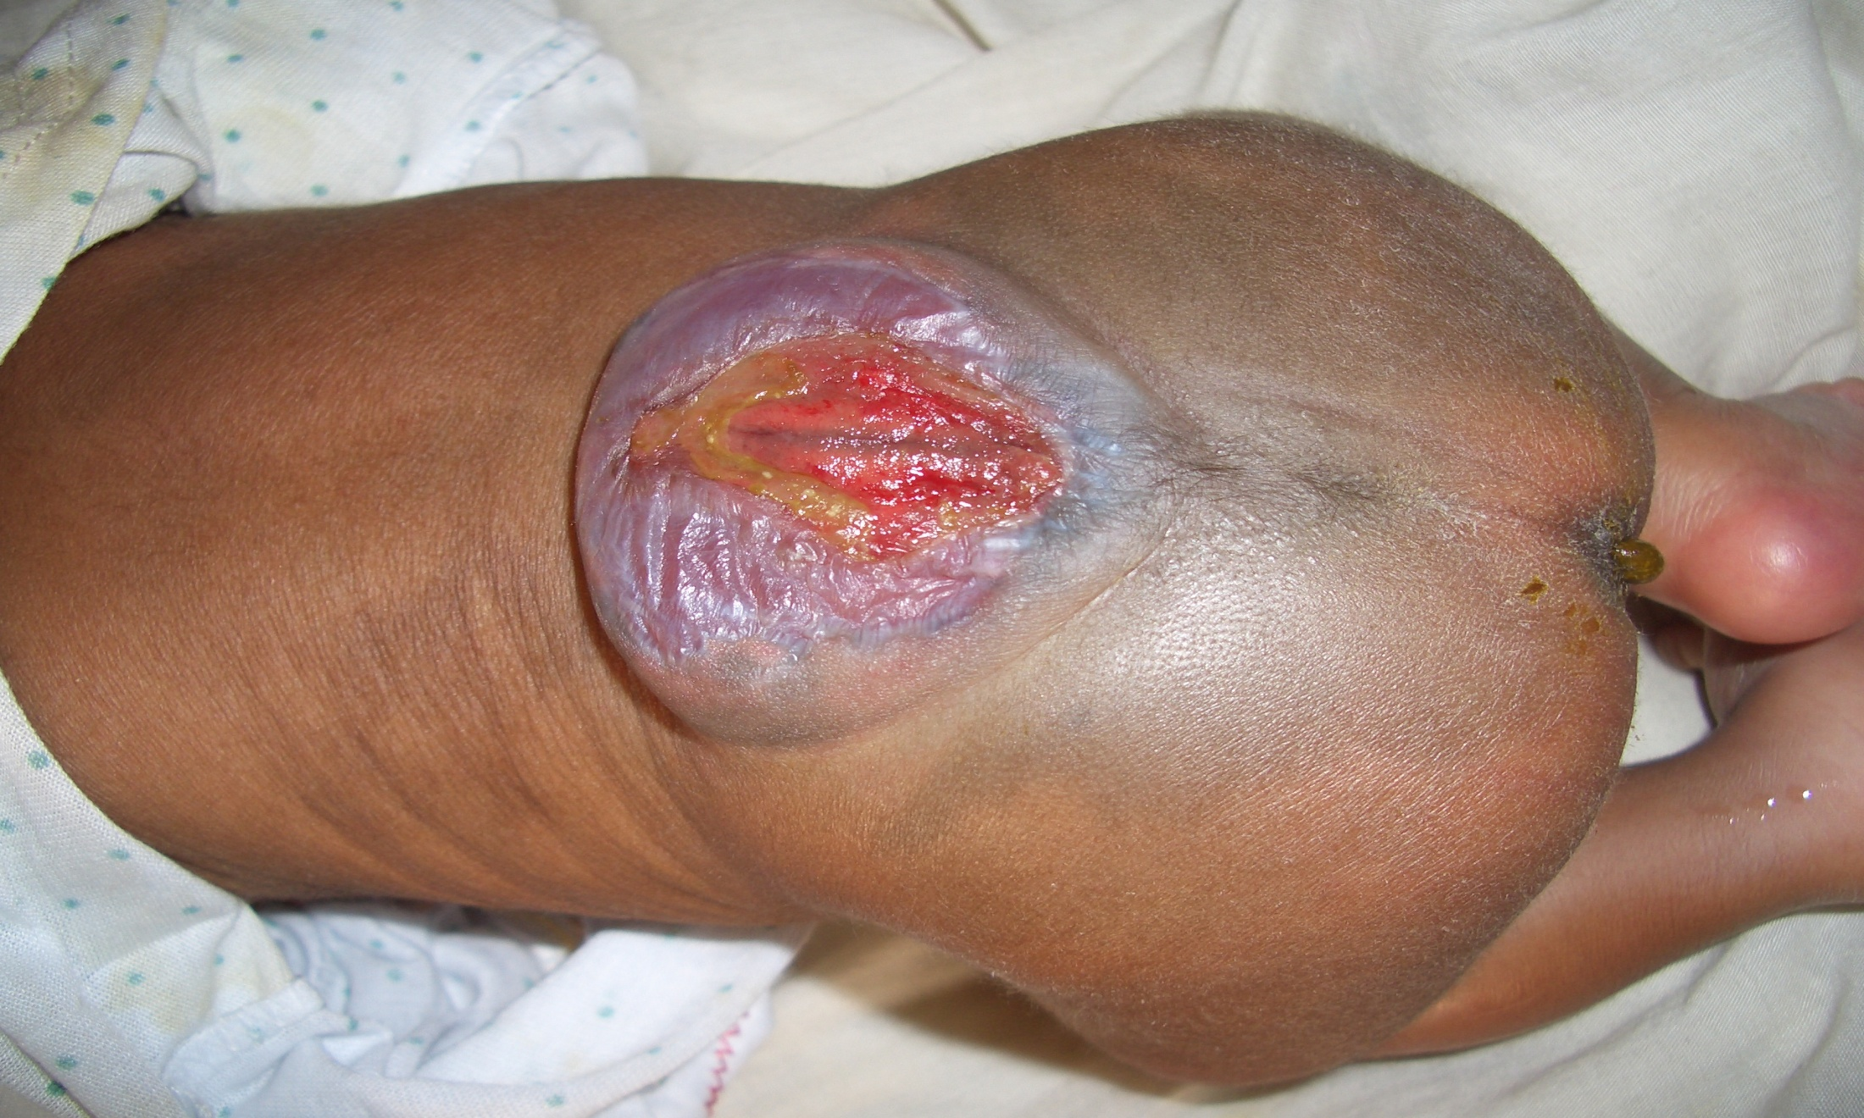

Slide 35
Concerning the picture above SPINAL BIFIDA
A] spastic paralysis of the lower extremities is commonly associated F
B]hydrocephalus is a common complication of the condition shown T
C] Management is multidisciplinary T
D] The anal sphincter may be relaxed T
E} This is ruptured lumbar myelomeningocele T

Slide 36
Review the case below
A 2 year old with anasarca,dyspnea and cough. Both parents are on antituberculous treatment. Weight -10.5kg, length 71cm, MUAC – 12cm
Generalized lymph node enlargement, moderate hepatosplenomegaly,increased cardiac dullness, muffling of the heart sounds
Distended neck veins and pulsus paradoxus

Slide 37
A] Child most likely will prefer to sit up in bed T
B] Chest x-ray will probably show water bottle configuration T
C] Pulses paradoxus confirmed with a drop of blood pressure greater than 20mmttg of systolic B.P. at end of inspiration T
D} Surgery may be indicated T
E] There may be associated positive kussmaul sign T

Slide 38
Review the patient below
A 12day old with vomiting, bloody stools, progressive abdominal distension of 2 days duration
Baby has been on infant formula since birth
Baby was delivered at 34 weeks gestation and weight was 1.8kg at birth

Slide 39
A] Necrotising enterocolitis is the most probable diagnosis T
B] The baby does not have any risk factors for the probable diagnosis F
C]Short gut syndrome is one of the complications of the probable diagnosis T
D] Plain abdominal x-ray is an important investigation T
E] The baby may have associated poor feeding T

Slide 40
Review the case below
A 10 month old male infant presented with excessive crying associated with drawing up of the legs of 12 hours duration. There was associated vomiting. In between attacks, child was well and playful.
Examination showed dehydration, fever, mild pallor.
Abdominal examination revealed sausage shaped mass, non tender and firm, in the mid abdomen. The right lower quadrant was less full than usual
DRE- examining hand stained with blood and mucoid stool.

Slide 41
A)The vomiting in this child is never bilous F
B] Plain abdominal x-ray will probably show air fluid levels and absence of gas in the right colon T
C] This child probably has intussusception T
D]This child may need surgery as a form of treatment T
E] nutritional history is important in this child T

Slide 42
THANK YOU FOR YOUR PARTICIPATION

